Slide 1
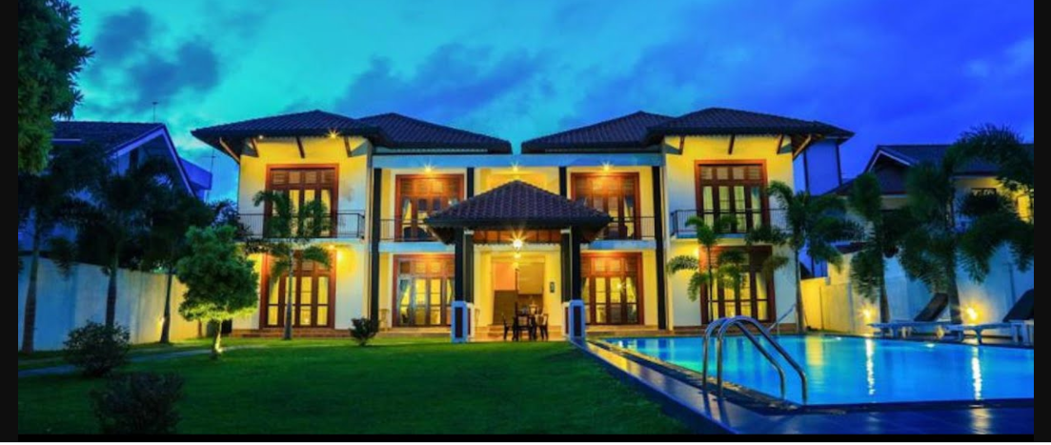
MARRIOTT HOTEL - EXECUTIVE PRESENTATION DATE:12/10/2020 PRESENTER: CLAYON BRODERICK

Slide 2
Governing Thoughts
High volume of cancelations for Marriott hotels rooms reservations have led to a 18% annual revenue loss due to failure to rent rooms after cancelation; hence, a proactive strategy is needed to detect reservation cancelations so that techniques can be implemented to help reduce reservation cancelations.

Slide 3
Executive Summary Slides
Descriptive and inferential statistical methodologies have proven effective in creating a proactive algorithm model with 77% accuracy to identify reservation that are likely to be canceled. Lead Time, Agent, Total Special Requests and previous cancelation emerging as some of the top variables of interest.
Reservations with lead time >30 days are more likely to be canceled.
Reservations with no special request are more likely to be canceled.
Reservations by repeated guests with high cancelation history are likely to cancel.
Booking with FB – Full board (breakfast, lunch and dinner) have highest rate of cancellations
Reservation with 1 more booking change(s) are less likely to be canceled.
Guests who requested parking don’t canceled reservation.

Slide 4
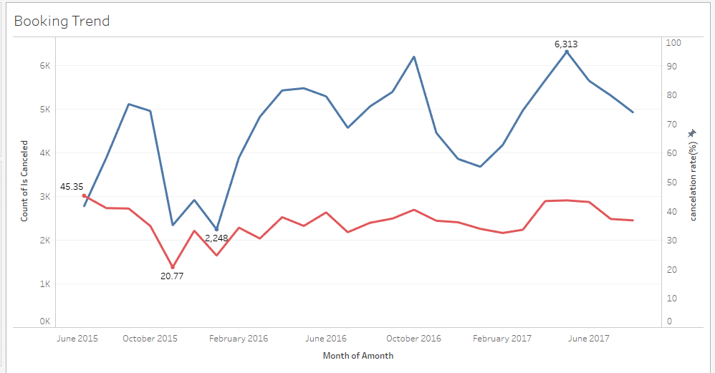
Over the two years period (2015-2017) the highest cancelation rate per month was in June 2015 (45.35% ) and the lowest cancelation rate was in October (20.77% ) of the same year. 2015 got the lowest total Bookings while June 2017 got the highest bookings for a month. Cancelation was slightly steady between 2016 and 2017.
Monthly Bookings and Cancelation Rate (%)
Total Bookings
Highest Booking
Cancelation Rate
Lowest cancelation rate
Lowest Bookings
Lowest cancelation rate

Slide 5
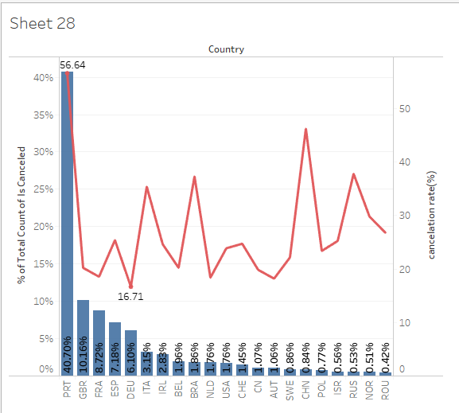
Over 94% of bookings were done by the top 20 countries, out of which 40.07% of those bookings were done by the host country, Portugal. The host country experienced the highest Cancelation rate (56.64 %). This indicates that bookings done by guests who do not have to travel are more likely to cancel. However, bookings from neighboring countries have low cancelation rates.
TOP 20 COUNTRIES
Host Country
Neighboring Countries

Slide 6
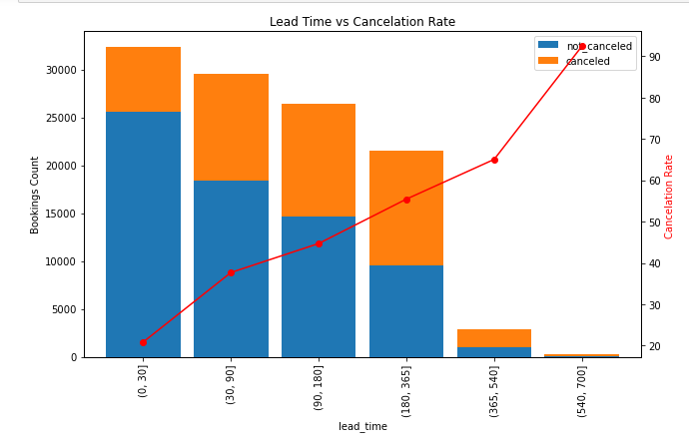
Splitting the lead time into periods; less than a month, month+ to 3 months, 3+ months to 6 months and so on, reveals a strong positive correlation between lead time and cancelation rate. Reservations made under a month prior to arrival date are less likely to be canceled while reservation with over a year early are most likely to be canceled.
6,577
25,606
65.1%
11,141
18,412
20.9%

Slide 7
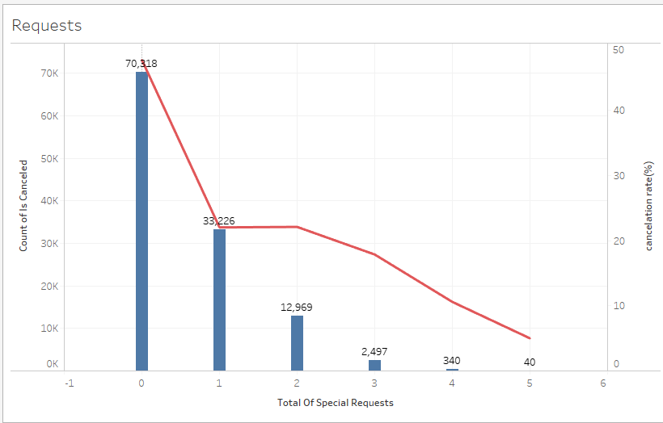
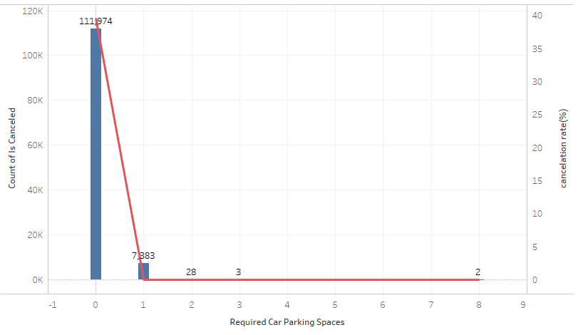
Here much can be taken from 2 key drivers, Total of Special requests and Required Car Parking Space which both have a strong negative correlation with cancelation rate. Reservation with no special request have almost a 50% cancelation rate. Similarly, reservation with no required car parking have almost a 40% cancelation rate. Notably, cancelation rate reduced significantly once there is an increment in either of the variables
SPECIAL REQUESTS AND CANCELATION RATE
REQUIRED PARKING AND CANCELATION RATE

Slide 8
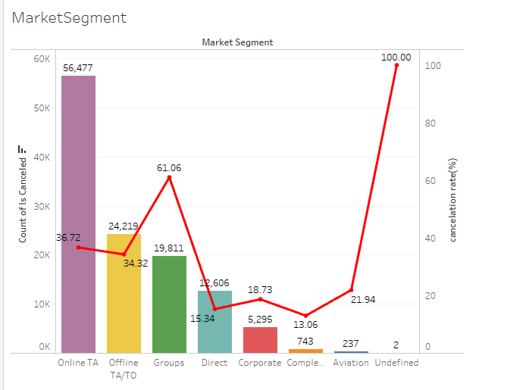
In market Segment, Online TA received approximately 50% of reservation with a cancelation rate of 36.72. significantly, we can see that group market segment experienced relatively high cancelation rate (61.06%).

Slide 9
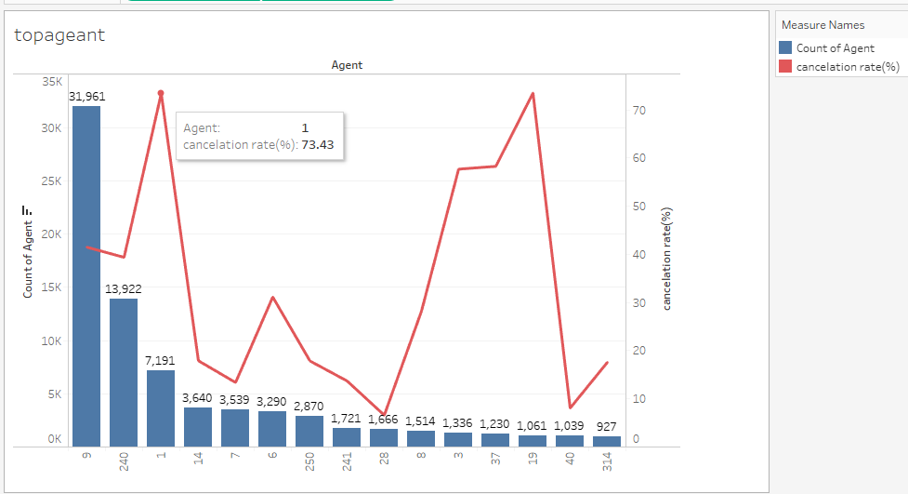
Analysis on Agent attribute reveals that bookings done agent #1 are sure likely to be canceled, as it has a cancelation rate over 73% . This is similar for gent #19 with approximately 74% cancelation rate. Agent #9 got highest number of bookings (26.8% of total bookings) and experienced 41% cancelation
Top 15 Agents
Agents

Slide 10
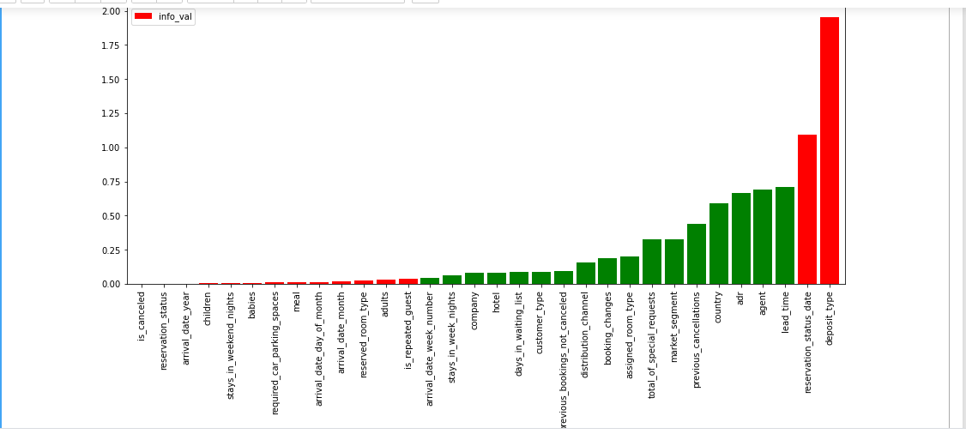
Multivariate Equation
Lead time, agent and country are some key variables that were identified using Information Value statistic. Using attributes with IV 0.04 > 0.8 gave the best accuracy rate at 0.77. This indicates that the model is capable to accurately identify approximately 77% of booking cancelations.
INFORMATION VALUES FOR VARIABLES
Bad variable
Good variable
We neglect IV that are less than 0.04. those are considered to be too weak
Selected variables

